Slide 1
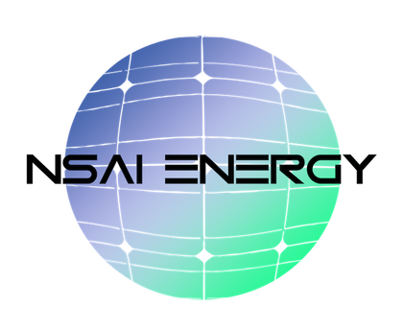
Domestic-Content-Aligned Solar + Storage
Procurement & Development Platform
Bringing the promise of the green economy and green jobs to forgotten people in forgotten places.
PROPRIETARY & CONFIDENTIAL

Slide 2
Leadership
Founder-Led, Execution-Focused Leadership
Keith Mathis
Co-Founder / Co-CEO
Karen Mathis
Co-Founder / Co-CEO
• 30+ years serving major utilities and energy stakeholders
• Deep experience in regulated, mission-critical environments
• Proven execution across infrastructure, procurement, and compliance
• Long-term, stewardship-driven leadership

Slide 3
Certifications & Authorization
Credentials That De-Risk Projects
• FERC Authorization (Market-Based Rate Authority)
• Diverse Business Enterprise (DBE)
• SBA / SBD
• ACORE
• SEIA
These credentials enable direct market participation, trusted counterparties, and accelerated execution.

Slide 4
Brand Evolution
Foundation
Built deep utility and infrastructure execution capability through decades of work in regulated environments.
Expansion
Formalized market access through FERC authorization and national certifications, enabling direct engagement with off-takers, utilities, and government partners.
Today
An integrated procurement and development platform designed for domestic content, financeability, and schedule certainty — built for the current market reality.

Slide 5
Investment Thesis
Procurement Risk Is Now Capital Risk
• Domestic content requirements materially affect tax credit value
• Supply chain certainty directly impacts financing and schedules
• Fragmented procurement increases diligence and execution risk
• Early, integrated procurement materially improves outcomes
NSAI exists to remove these risks before capital is committed.

Slide 6
Platform Advantage
A Procurement Platform Designed to Survive Diligence
• Integrated solar + storage procurement under one accountable counterparty
• Domestic-content-aligned and FTA-compliant supply strategies
• Procurement structured to meet lender and investor standards
• Schedule certainty during constrained construction windows
• Early engagement reduces re-papering and execution friction

Slide 7
Current Commercial Offering
What NSAI Delivers Today
• Solar Modules
– American-made modules
– Moroccan-manufactured modules (FTA / tariff-advantaged)
• Trackers (American-Made)
– Single-axis
– Dual-axis
• Energy Storage
– Integrated solar + storage procurement
All offerings are aligned with compliance, finance ability, and
schedule certainty — not commodity sales.

Slide 8
R&D - Not Selling Today
Disciplined Focus on Execution
• Wind to Energy — Exploratory / future evaluation only
• Wind to Hydrogen — Exploratory / future evaluation only
No current revenue assumptions.
No near-term execution claims.
Innovation evaluated responsibly through partnerships and R&D.

Slide 9
Why Investors Partner with NSAI
Protecting Capital, Tax Credits, and Timelines
• Procurement aligned with diligence requirements
• Reduced eligibility and compliance risk
• Improved time-to-NTP and execution certainty
• Scalable, repeatable platform model
• Clear accountability across procurement and development

Slide 10
Closing & Contact
A Platform Built for This Market
Domestic content is permanent.
Procurement determines finance ability.
Early engagement creates advantage.
Keith Mathis — Co-Founder / Co-CEO
Keith.mathis@NSAIenergy.com | 858-945-6747
Karen Mathis — Co-Founder / Co-CEO
Karen.mathis.NSAIenergy@gmail.com | 858-945-6819
www.nsaienergydevelopment.com

